Slide 1

Hello
Everyone

Slide 2

Welcome To AI Project Presentation

Slide 3


Presented By
Mohammad Maruf Islam
ID: 2014-1-60-009
Fahmida Noor
ID: 2014-1-60-010

Slide 4
Overview
What is the problem?
Solution
How it will work
Sample Input/output
Code section
Advantages

Slide 5
What Is the problem?
Situation is,
More than 175 pharmaceuticals companies
Worth over 2400 crore taka business
Most of the companies use of information technology is mainly focused on supply chain management.
Future production decision are still made based on human calculation
Disease analysis and future disease prediction is absent in their
system
Long term effect is not calculated through a smart system
Use of old market strategy based on human calculation

Slide 6

Solution
We
Have
A
Solution
!!!

Slide 7
Disease Observation and Forecasting System
EWU
This project is a part of CSE 365 Course, East West University

Slide 8
Solution
Disease Observation and Forecasting System is written in prolog
language
This system will use data from current market
Using the data it will predict the needed medicine
System will be able to tell the long term effect on medicine data
This system can provide prediction of future effect on a large population

Slide 9
How it will
do it ?

Slide 10
How it will do it
In the system, we used the general theory of probability
Number of sold medicines across the region will be collected through medical representatives
We have added 18 medicines of various type as a input
After giving the input the system will find out the probability of each medicine
In the next step, it will find the maximum probability of the particular medicine
Then the system will find match with given database in the program
After matching, it will give the data of future diseases for which the company should produce medicines

Slide 11
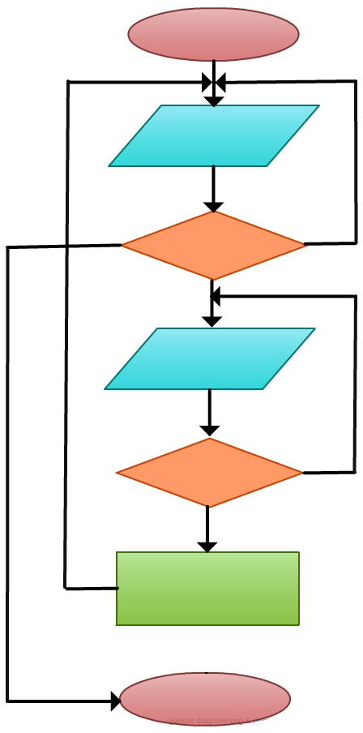
How it will do it
The Flow Chart of the System
Start
Menu
1. Compute
2. Exit
Invalid Input
2. Exit
Menu
1. Compute
Input Data
NO
Is Valid Input?
YES
Compute Data
Stop

Slide 12
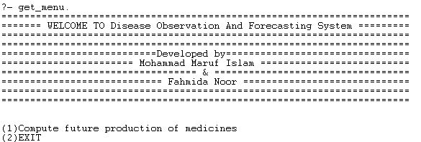
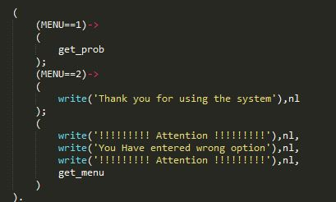
Sample Input/output
User interface of Menu
Code of Menu section

Slide 13
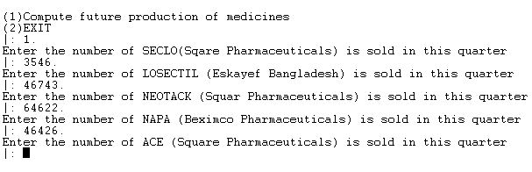
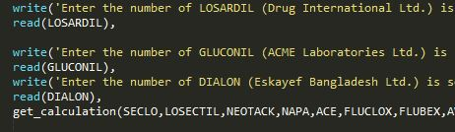
Sample Input/output
User interface of Input
Code of Input data section

Slide 14
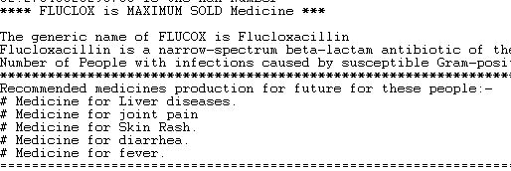
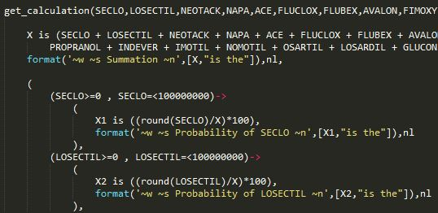
Sample Input/output
User interface of Output
Code of Output section

Slide 15
Advantages
This system will provide a database of medicine sold
System will predict the future disease information
Disease analysis information can be used later
This system can help the pharmaceutical industry as well as the entire health sector
Combination of machine intelligence (Faster) and human intelligence we can go ahead more faster in future.
Precautions can be taken in advanced

Slide 16
Any
Questions?
EWU
This project is a part of CSE 365 Course, East West University

Slide 17




